Slide 1
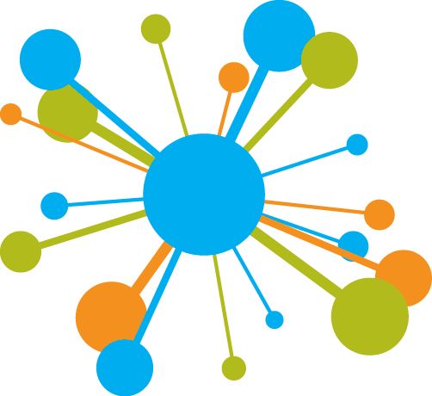
Unsupervised Learning
Learning without a teacher
Yordan Darakchiev
Technical Trainer
yordan@softuni.bg

Slide 2
Sli.do
#softuni-unsup

Slide 3
Table of Contents
Unsupervised learning – problem description
Clustering – problem description, approaches
k-means clustering
kMeans++
Hierarchical clustering
Clustering and classification
Evaluating classification performance
Recommender systems
Problem description, objective, types
Collaborative filtering

Slide 4
Clustering Analysis
Finding clumps in data

Slide 5
Clustering Analysis
Unsupervised learning
Discover hidden structures in data where we don't know the right answer upfront
Clustering
Find a natural grouping in data such that items in the same cluster are more similar to each other than those from different clusters
Some applications
Medicine: classify different types of tissues
Marketing: group similar products
Social network analysis
Image segmentation, object recognition
Crime analysis: "hot" spatial areas; similar crimes

Slide 6
k-Means Clustering
Prototype-based algorithm
Each cluster is represented by a "prototype" data point
As opposed to density-based
Algorithm
Select number of clusters
Randomly pick samples as "initial centroids"
Repeat until convergence (change in centers < tolerance):
Assign each sample to the nearest (using distance metric) centroid
Move the centroids to the center of the newly created clusters
Advantages: fast, simple, good for "spherical" clusters
Disadvantages: we need to specify , doesn't work too well with overlapping or hierarchical clusters

Slide 7
k-Means Clustering (2)
Objective function
Minimize the cluster inertia – within-cluster sum of squared errors (Eucledian distances)
Generating clusters
We can use scikit-learn to generate "blobs" (clusters)
Other options – "circles", "moons", etc.
from sklearn.datasets import make_blobs
attributes, clusters = make_blobs(cluster_std = 1)
plt.scatter(attributes[:, 0], attributes[:, 1], c = clusters)
from sklearn.datasets import make_blobs, make_circles, make_regression, make_s_curve, make_swiss_roll
# The last two are 3D – you can either plot them # or see their projections using the x and z axes

Slide 8
Lab: k-Means Clustering
Generate several datasets
Blobs, circles, moons
Apply k-means clustering
Display the original clusters and the clustering results
* How do they differ? Can you explain why?
from sklearn.cluster import Kmeans
attributes, clusters = make_blobs()
k_means = KMeans(3, init = "random")
assigned = k_means.fit_predict(attributes)
plt.scatter(attributes[:, 0], attributes[:, 1], c = clusters)
plt.show()
plt.scatter(attributes[:, 0], attributes[:, 1], c = assigned)
plt.show()

Slide 9
k-Means++
Random initial seed => may lead to poor performance
If the initial points aren't placed well enough or if the clusters are too "mixed"
k-Means++ uses centers which are far away from each other
Instead of random initialization
Algorithm
Choose the first centroid uniformly at random
To choose the next centroids, use a weighted probability distribution
Based on all currently selected centroids
Further away = greater probability
After all centroids have been initialized, proceed as usual

Slide 10
Lab: k-Means++
Generate several datasets
Blobs, circles, moons
Apply k-means++
Compare the performance of k-means++ versus k-means on blobs that are "close" to each other
Generate blobs with a higher standard deviation
Plot the centroids
* Count the misclassified points for the two algorithms
attributes, clusters = make_blobs()
k_means = KMeans(3, init = "k-means++")
assigned = k_means.fit_predict(attributes)

Slide 11
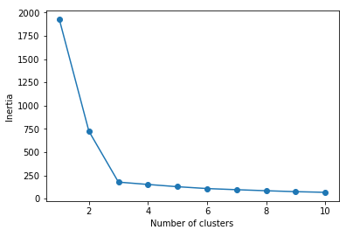
Finding an Optimal Number of Clusters
Elbow method – graphical
Inertia is a measure of clustering quality
Like grid search, initialize KMeans with a range of hyperparameters
Fit and calculate the inertia (given by default in scikit-learn)
Plot inertia vs. number of clusters
Find the "elbow point" of the plot – optimal
Inertia always decreases but some models overfit the data
inertias = []
for i in range(1, 11):
km = KMeans(n_clusters = i)
km.fit(X)
inertias.append(km.inertia_)
plt.plot(range(1,11), inertias, marker = "o")
plt.xlabel("Number of clusters")
plt.ylabel("Inertia")
plt.show()

Slide 12
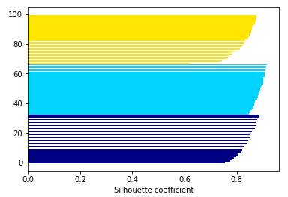
Evaluating Clustering Quality
Silhouette analysis – graphical
Use cluster cohesion (within-cluster distance) and cluster separation (between-cluster distance) to calculate the silhouette coefficient
Silhouette coefficient: [-1; 1], 0 if the two distances are equal, 1 – ideal
Usage – import from scikit-learn and plot
Interpretation
Each color is a separate cluster
All silhouettes should be close to 1 (these are bar charts)
All silhouettes have a similar "depth" and "width" (if they don't => suboptimal clustering)
from sklearn.metrics import silhouette_samples

Slide 13
Lab: Silhouette Plots
Perform a k-means clustering on 3 blobs
Initialize three algorithms to look for 2, 3 and 4 clusters
Plot the silhouettes and inspect them
from sklearn.metrics import silhouette_samples
import matplotlib.cm
km = KMeans(3) # Also, 2 and 4
predicted = km.fit_predict(attributes)
silhouette_vals = silhouette_samples(attributes, predicted)
y_min, y_max = 0, 0
y_ticks = []
for i, c in enumerate(cluster_labels):
c_silhouette_vals = silhouette_vals[predicted == c]
c_silhouette_vals.sort()
y_max += len(c_silhouette_vals)
color = matplotlib.cm.jet(i / cluster_labels.shape[0])
plt.barh(range(y_min, y_max), c_silhouette_vals, color = color)
y_min += len(c_silhouette_vals)
plt.xlabel("Silhouette coefficient")

Slide 14
Hierarchical Clustering
Another prototype-based clustering
Advantage – allows us to plot dendrograms
Visualizations of binary hierarchical clustering
Allow us to interpret the results
Algorithm
Compute the distance matrix (distances between any two points)
Start with each point at its own cluster
Repeat until only one cluster is left:
Merge the two closest clusters and update the distances
Update the distance matrix
In scikit-learn, linkage describes the process of linking
from sklearn.cluster import AgglomerativeClustering
aggl = AgglomerativeClustering(n_clusters = 3, linkage = "complete")

Slide 15
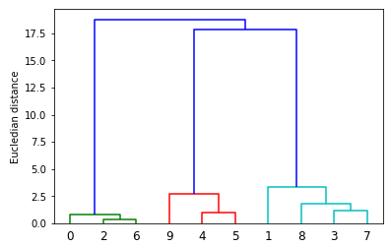
Lab: Hierarchical Clustering
Perform hierarchical (agglomerative) clustering on several datasets and visualize the results
Blobs, moons, nested circles
Try different linkage strategies
Plot a dengrogram
linkage() calculates a distance matrix
dendrogram() creates the plot (x-axis: ID, y-axis: distance)
from scipy.cluster.hierarchy import linkage, dendrogram
row_clusters = linkage(attributes, method = "complete", metric = "euclidean")
row_dendr = dendrogram(row_clusters, labels = clusters)

Slide 16
DBSCAN
Density-based Spatial Clustering of Applications with Noise
Label all points as "core points" or "noise points"
Core point: has at least points within radius
Use core points to create clusters
DBSCAN vs. k-means
Noise points are not assigned to any cluster
Does not assume spherical shape
Disadvantages: "curse of dimensionality", the hyperparameters need to be optimized
Usage – like other clustering algorithms
from sklearn.cluster import DBSCAN
db = DBSCAN(eps = 0.2, min_samples = 5, metric = "euclidean")

Slide 17
Lab: DBSCAN
Compare the performance of DBSCAN to the other clustering algorithms
Use the datasets and results from the previous lab
Which algorithm performs best on which dataset?
Clustering comparison in scikit-learn
Conclusion
It's not always obvious which algorithm performs best on a dataset
Especially if data comes in many dimensions
A successful clustering depends on the algorithm and its hyperparameters
We need to choose an appropriate distance metric
We need some domain knowledge

Slide 18
* Lab: Classifying Handwritten Digits
Some classification problems can be solved using clustering
Download and explore the MNIST dataset of digits
Idea: the same digits are written somewhat similarly
Problem: how to represent the data?
Quick and simple solution: array of pixels (2D -> 1D)
Other solutions: PCA, feature engineering, edge detection, …
Apply k-means to the datasets
How many clusters? We can start with 10 but it's better to optimize
Apply other algorithms (hierarchical clustering, DBSCAN, kNN, SVM, random forest, logistic regression, naïve Bayes, etc.) and compare their performance
Test the performance (like a classification problem)
See also the performance data on the authors' website

Slide 19
Recommender Systems
Giving people what they want

Slide 20
Recommender Systems
Predict the rating or "preference" that a particular user will have for a particular product
Examples: personalized ads, products which are frequently bought together, restaurants, people (social networks), etc.
Main challenge: data sparsity (too little data is available)
"Utility function" – should take into account
Past user behavior
Relations between users
Relations between items
Context, etc.
Goal: maximize the utility function
Typical workflow: collect ratings; find people with most "similar" tastes, recommend new (unfamiliar) items

Slide 21
Collaborative Filtering
Idea: get a recommendation from many people (like we do in real life)
User-based
Look for users with the same rating patterns (e.g. using kNN, select the "closest" other users)
Use others' rating to predict the rating for the active user
Item-based
Build an item-item matrix describing item relationships
Infer the active user's tastes by matching user data with the matrix
Hybrid
Data collection
Explicit: the user rates an item
Implicit: the user suggests a rating passively (e.g. stops a song too early / repeats a song many times)

Slide 22
The Netflix Prize
$1 million for improving recommendations
21 September 2009 – BellKor, 10% improvement
First finding: it's very easy to generate a good prediction but very hard to optimize it
Solution: LDA (Latent Dirichlet Allocation)
Matrix factorization (complex math but simple idea)

Slide 23
Lab: Collaborative Filtering
LDA
Rather complex math, but a simple idea
Example: movies
Each user has some "essence" (vector) of what genres they prefer
Each movie can be expressed in the same "essence" terms
A rating is the dot product of a user vector and a movie vector
Goal: given the (user, movie) matrix, calculate the essence matrix
After that, new ratings can be predicted by simple dot products
Follow this tutorial to create a simple recommender system using collaborative filtering
Preprocess the data, apply LDA, generate predictions
* How can the system be improved?

Slide 24
* Lab: Restaurant Data
Obtain the restaurant ratings data from here
Best transform it into 3 datasets: user info, restaurant info, ratings
Try to clean and explore the data
Perform simple collaborative filtering using only the ratings
Optionally, try item-item and user-user based predictions
Incorporate the restaurant and user profiles to get a better picture of their preferences
Try user clustering based on profiles
Try restaurant clustering
Combine the results of several algorithms (e.g. collaborative filtering and clustering), e.g. using majority votes

Slide 25
Summary
Unsupervised learning – problem description
Clustering – problem description, approaches
k-means clustering
kMeans++
Hierarchical clustering
Clustering and classification
Recommender systems
Problem description, objective, types
Collaborative filtering

